Slide 1
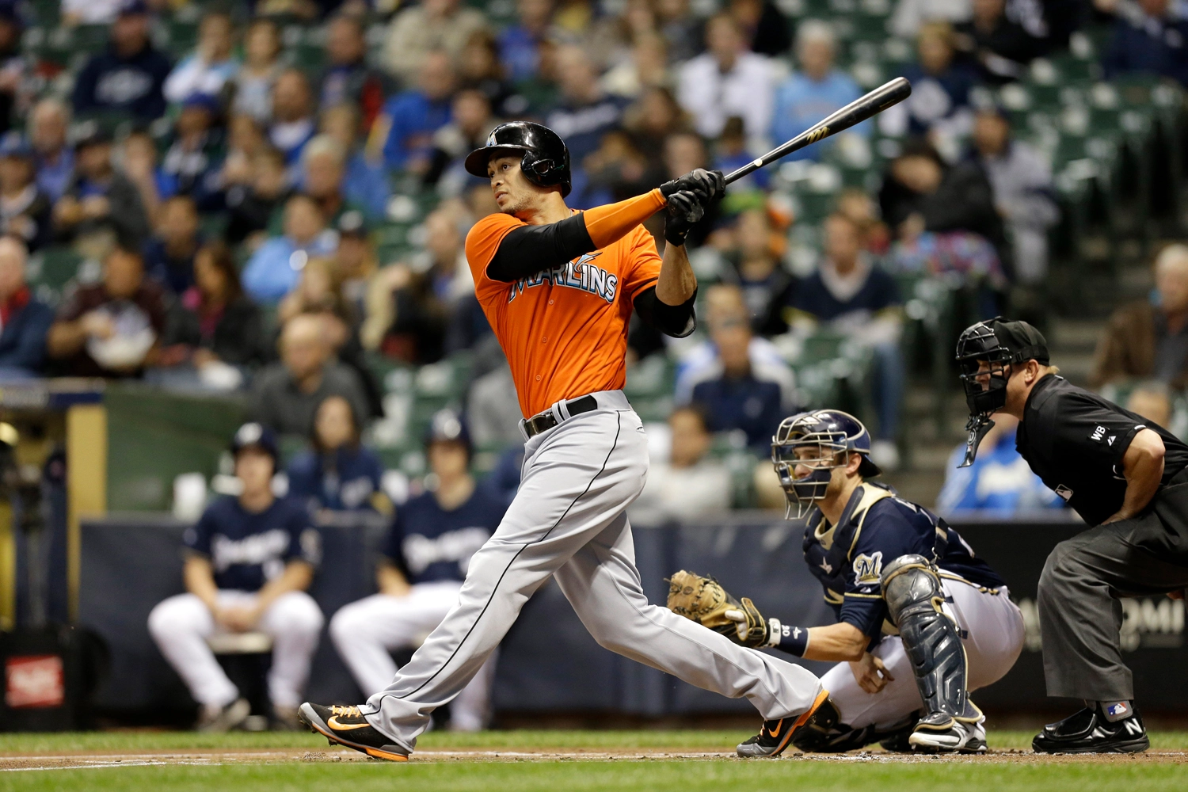
Giancarlo Stanton (2017)
.281 AVG, 59 Home Runs, 132 RBI, 123 Runs

Slide 2
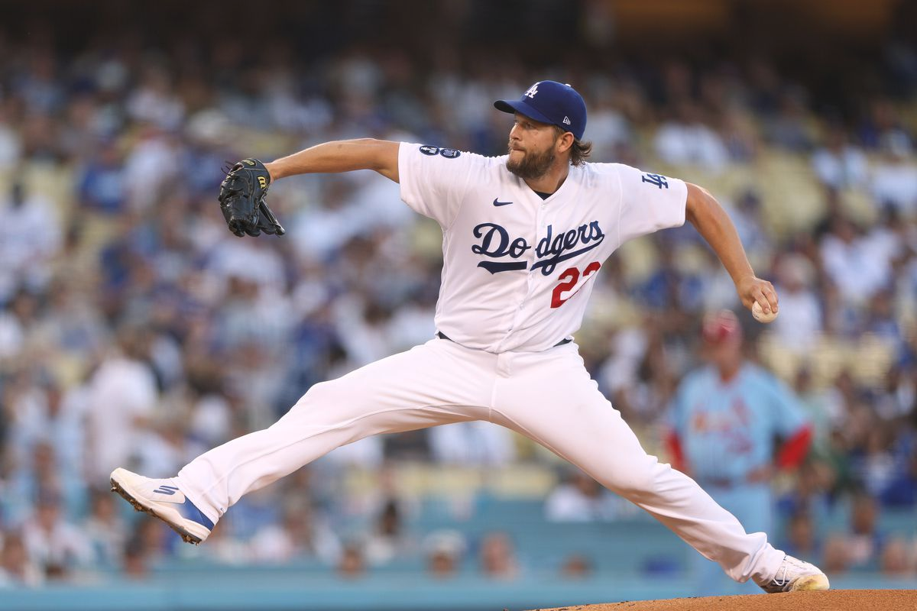
Clayton Kershaw (2014)
21 Wins, 1.77 ERA, 239 Strikeouts, 0.86 WHIP

Slide 3
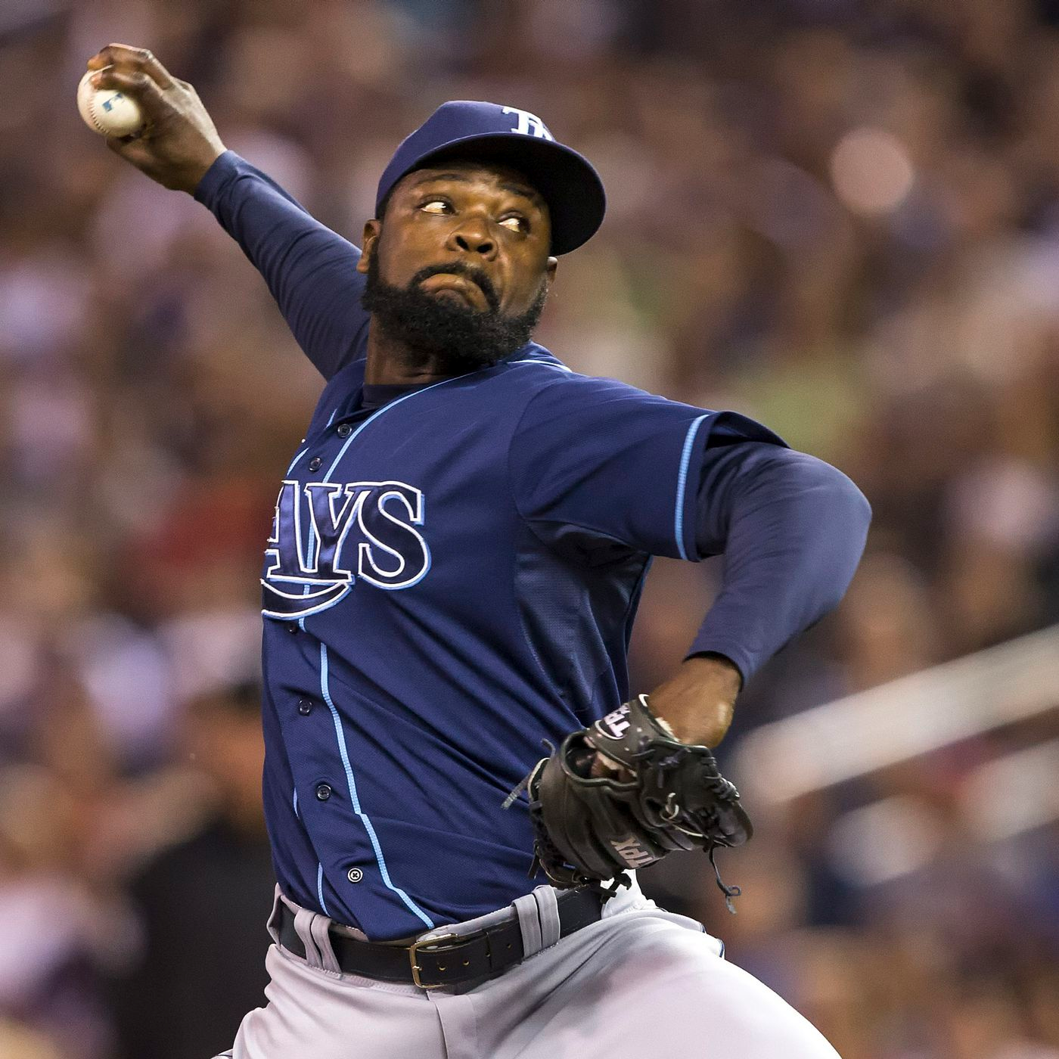
Fernando Rodney (2012)
0.60 ERA, 48 Saves, 76 Strikeouts, 0.78 WHIP

Slide 4
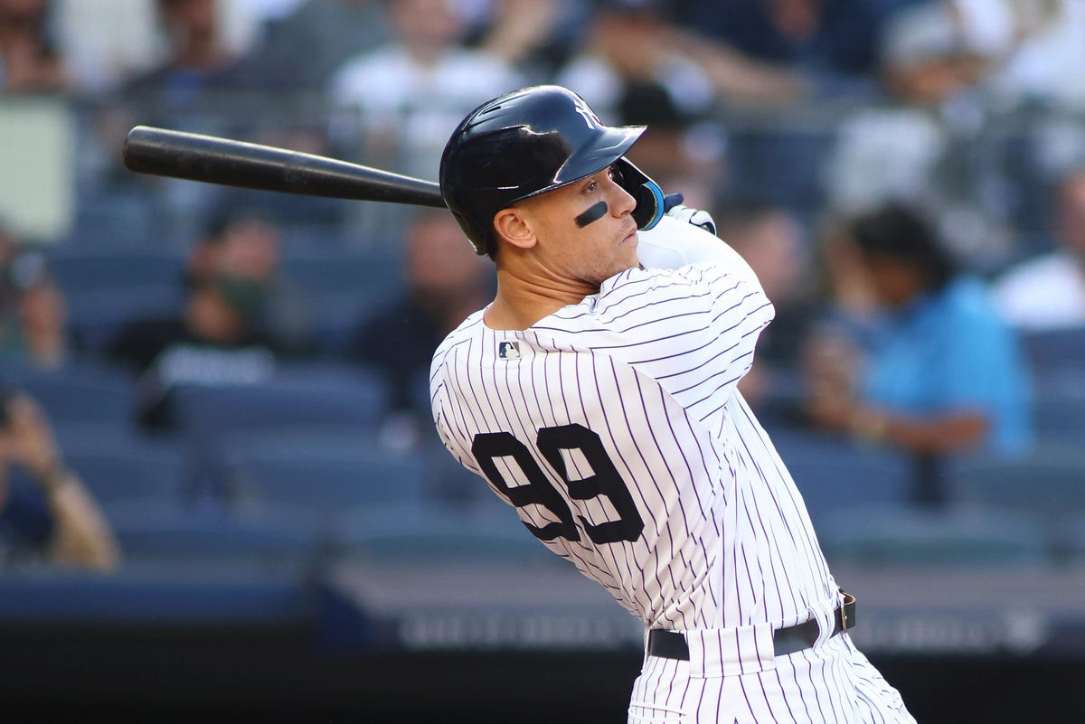
Aaron Judge (2022)
.311 AVG, 62 Home Runs, 131 RBI, 133 Runs, 16 Steals

Slide 5
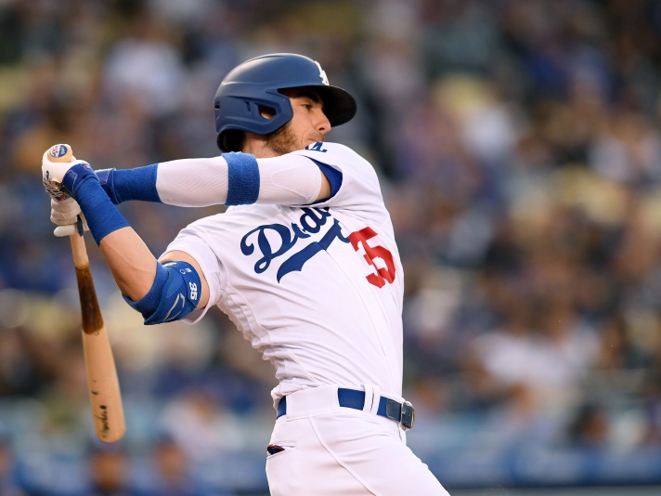
Cody Bellinger (2019)
.305 AVG, 47 Home Runs, 115 RBI, 121 Runs, 15 Steals

Slide 6
Other player ideas
Gerrit Cole (2019) – 20 Wins, 2.50 ERA, 326 Strikeouts, 0.90 WHIP
Justin Verlander (2011) – 24 Wins, 2.40 ERA, 250 Strikeouts, 0.92 WHIP
Jose Reyes (2007) - .280 AVG, 12 Home Runs, 57 RBI, 119 Runs, 78 Steals

